Slide 1
VIEW

Slide 2

Part 3.
VIEW

Slide 3
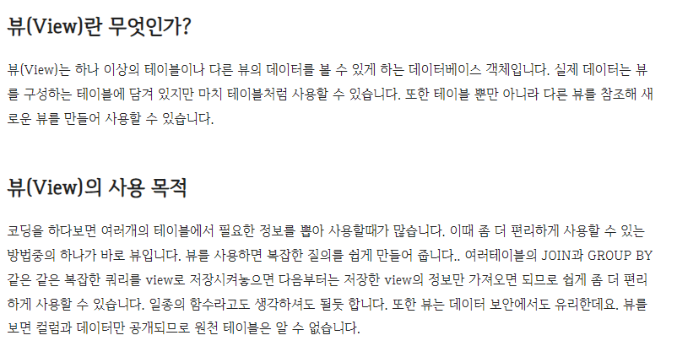
chaper 12
01
VIEW

Slide 4
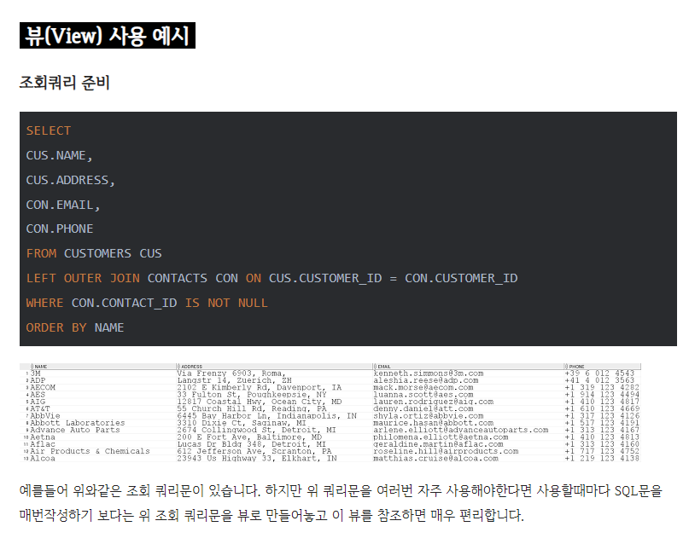
chaper 12
01
VIEW

Slide 5
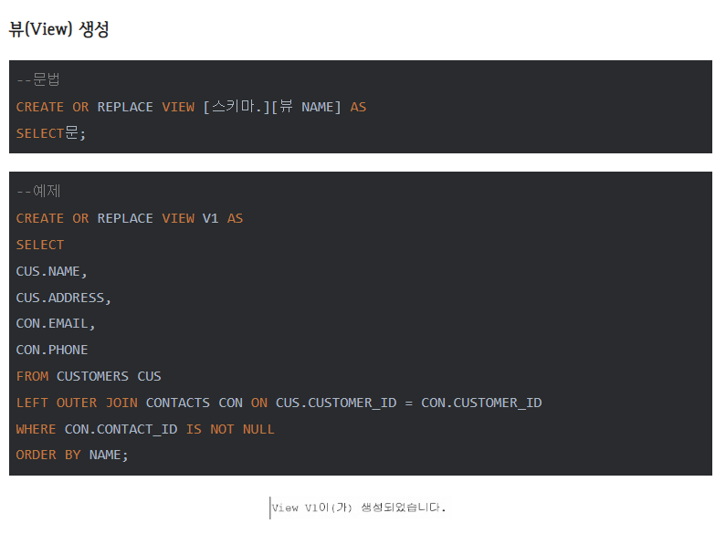
chaper 12
01
VIEW

Slide 6
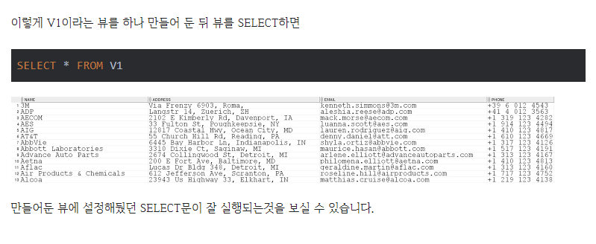
chaper 12
01
VIEW

Slide 7
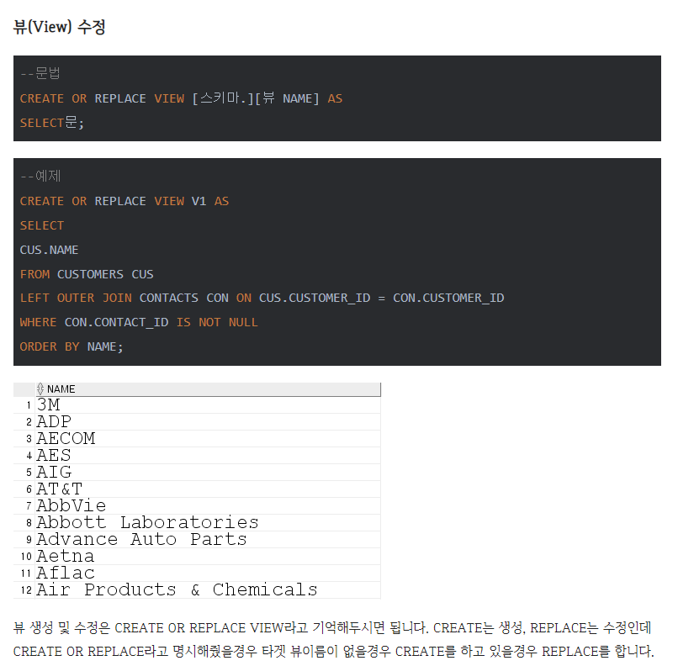
chaper 12
01
VIEW

Slide 8
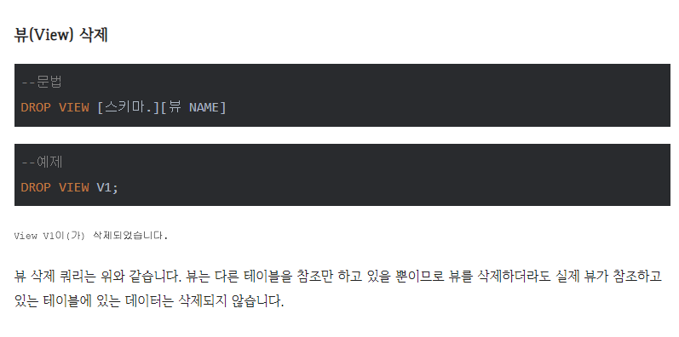
chaper 12
01
VIEW

Slide 9

chaper 12
01
VIEW

Slide 10
E N D.
고생하셨습니다

